Slide 1
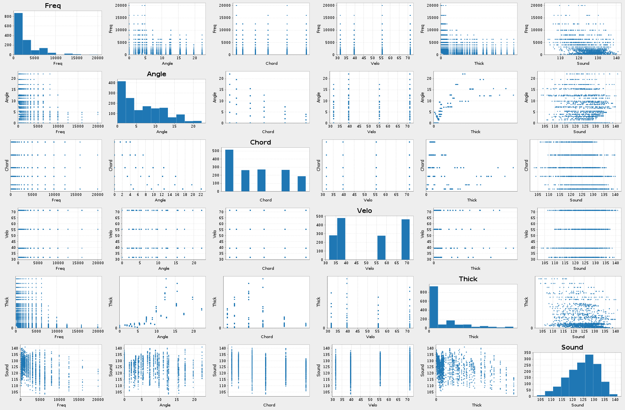
Regression Modelling
WQD7001

Slide 2
Types of Regression
Linear regression
Logistic regression
Polynomial regression
Stepwise regression
Stepwise regression
Ridge regression
Lasso regression
ElasticNet regression
Linear and Logistic regressions are usually the first modeling algorithms that people learn for Machine Learning and Data Science.

Slide 3
Logistic regression is the most famous machine learning algorithm after linear regression.
In a lot of ways, linear regression and logistic regression are similar. But, the biggest difference lies in what they are used for.
If you are dealing with continuous / discrete values, then go for Linear Regression.
Linear regression algorithms are used to predict/forecast values.
If you are dealing with a classification problem like (Yes/No, Fraud/Non Fraud) then use Logistic Regression.
Logistic regression is used for classification tasks.
classifying whether an email is a spam or not,
classifying whether a tumor is malignant or benign,
classifying whether a website is fraudulent or not, etc.

Slide 4
Independent and Dependent Variables
In the context of Statistical learning, there are 2 types of data:
Independent variables: Data that can be controlled directly.
Dependent variables: Data that cannot be controlled directly.
The data that can’t be controlled (dependent variables) need to be predicted or estimated.
A model is a transformation engine that helps us to express dependent variables as a function of independent variables.
Parameters: are ingredients added to the model for estimating the output.
Linear regression models provide a simple approach towards supervised learning. They are simple yet effective.

Slide 5
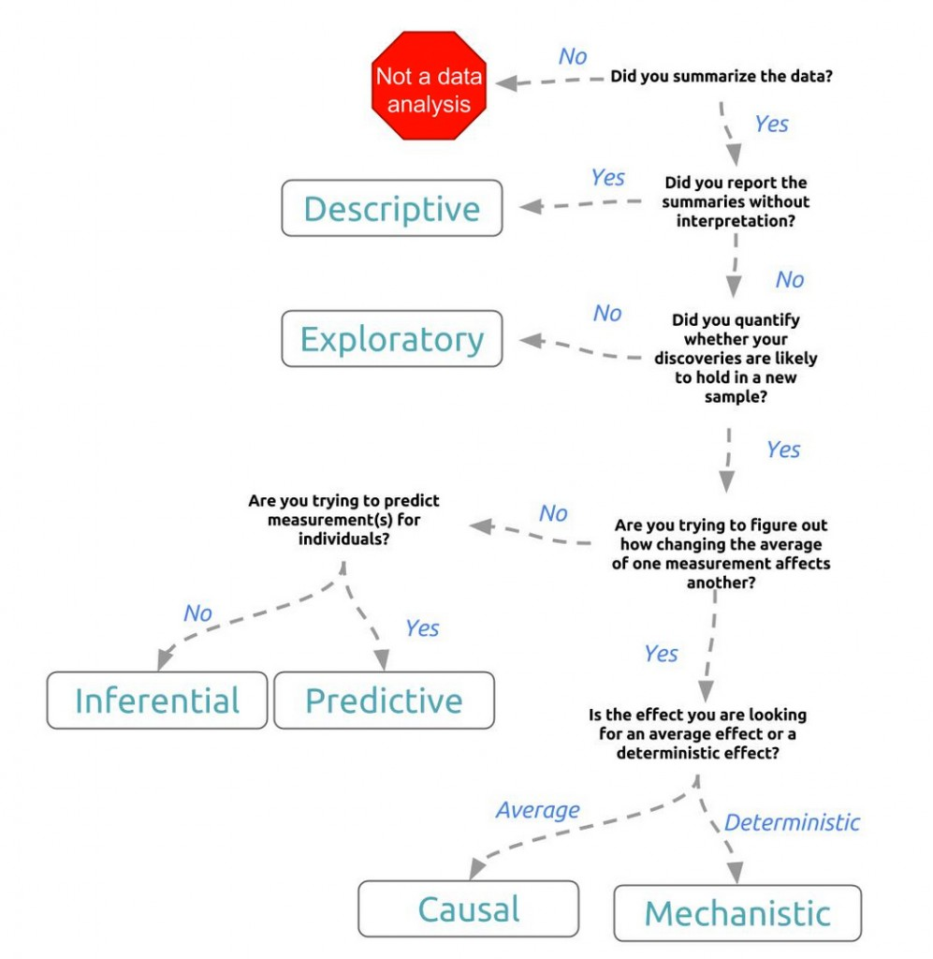
Stages of Analysis
https://www.cuelogic.com/blog/the-workflow-of-data-analytics

Slide 6
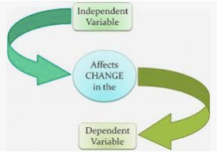
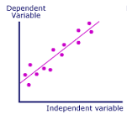
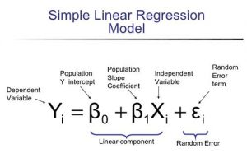
Naming the Variables
There are many names for :
Regression’s dependent variable (Y axis). It may be called an outcome variable, criterion variable, endogenous variable, or regressand.
The independent variables (X axis)can be called exogenous variables, predictor variables, or regressors.

Slide 7
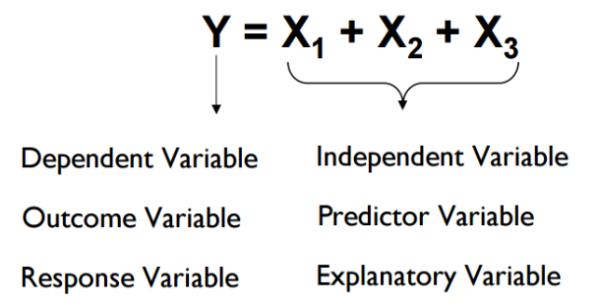

Slide 8
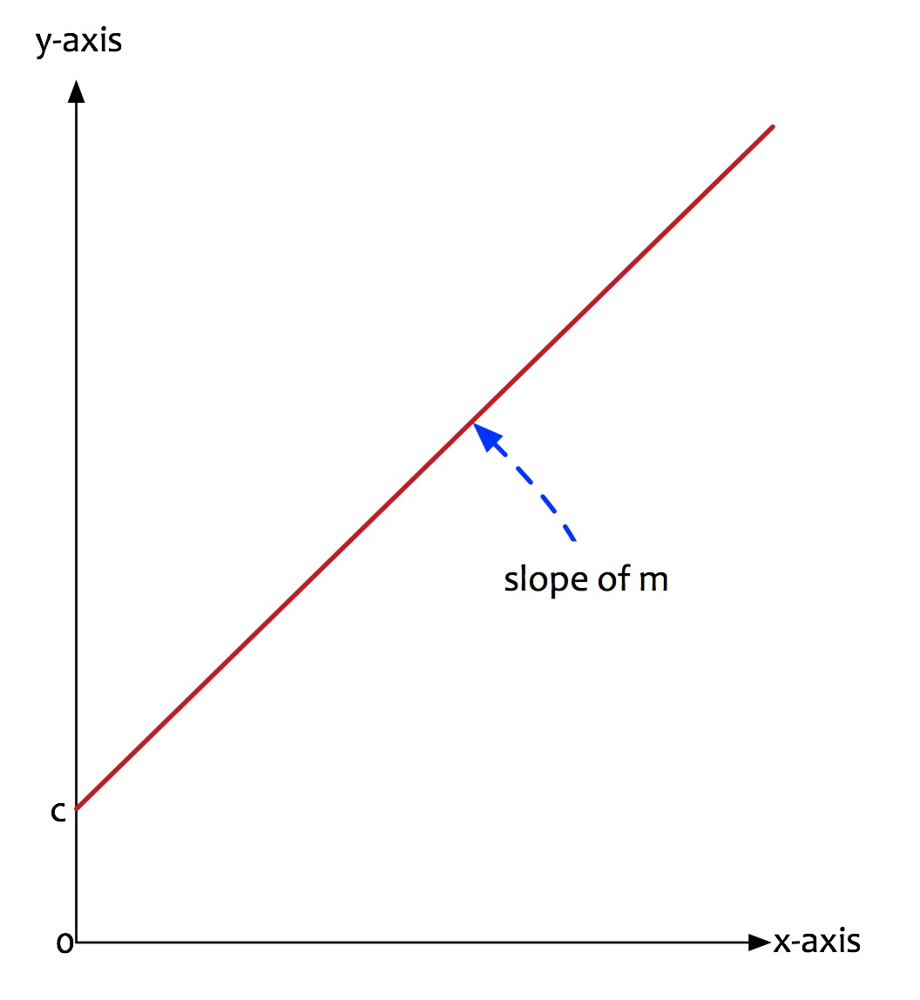
What do we mean by linear?
Linear implies the following:
arranged in or extending along a straight or nearly straight line.
Linear suggests that the relationship between dependent and independent variable can be expressed in a straight line.
What is the equation of a line? Recall the geometry lesson that you’d learnt
y = mx + c
Linear regression is nothing but a manifestation of this simple equation.
y is the dependent variable i.e. the variable that needs to be estimated and predicted.
x is the independent variable i.e. the variable that is controllable. It is the input.
m is the slope. It determines what will be the angle of the line. It is the parameter denoted as β.
c is the intercept. A constant that determines the value of y when x is 0.

Slide 9
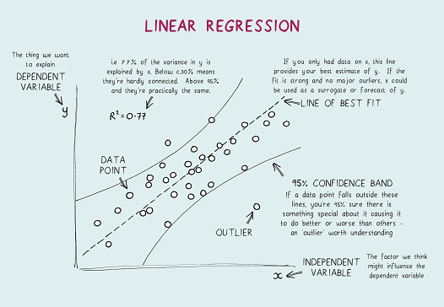

Slide 10
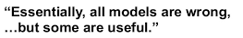

Any model, no matter how accurate is still some type of simplification or generalization of something.
British Mathematician and Professor of Statistics
Linear regression models are not perfect.
It tries to approximate the relationship between dependent and independent variables in a straight line.
Approximation leads to errors.
Some errors can be reduced.
Some errors are inherent in the nature of the problem.
These errors cannot be eliminated. They are called as an irreducible error, the noise term in the true relationship that cannot fundamentally be reduced by any model.

Slide 11
What is Linear Regression?
Most commonly used method for predictive analytics.
Method used to describe relationship between a dependent variable and one or independent variable.
The main task in the Linear Regression is the method of fitting a single line within a scatter plot.
The Linear Regression consists of the following three steps:
Determining and analyzing the correlation and direction of the data
Deploying the estimation of the model
Ensuring the usefulness and validity of the model

Slide 12

1. Determining and analyzing the correlation and direction of the data
Firstly, a scatter plot should be used to analyze the data and check for directionality and correlation of data.
Look for (i) linear or non-linear pattern of the data and (ii) deviations from the pattern (outliers).
If the pattern is non-linear, consider a transformation.
If there are outliers, you may consider removing them only IF there is a non-statistical reason to do so.
This step enables the data scientist to formulate the model.

Slide 13

2. Deploying the estimation of the model
The second step of regression analysis is to fit the regression line.
Fit the least-squares regression line to the data and check the assumptions of the model by looking at the Residual Plot (for constant standard deviation assumption) and normal probability plot (for normality assumption).
Once a “good-fitting” model is determined, write the equation of the least-squares regression line. Include the standard errors of the estimates, the estimate of , and R-squared

Slide 14
3. Ensuring the usefulness and validity of the model
The last step for the linear regression analysis is the test of significance, which is evaluating the validity and usefulness of the model.
Determine if the explanatory variable is a significant predictor of the response variable by performing a t-test or F-test.
Include a confidence interval for the estimate of the regression coefficient (slope).

Slide 15
Example: Workings of a Linear regression Model
Fernando is a Data Scientist. He wants to buy a car. He wants to estimate or predict the car price that he will have to pay. He has a friend at a car dealership company. He asks for prices for various other cars along with a few characteristics of the car. His friend provides him with some information.
The following are the data provided to him:
make: make of the car.
fuelType: type of fuel used by the car.
nDoor: number of doors.
engineSize: size of the engine of the car.
price: the price of the car.

Slide 16
Example: Workings of a Linear regression Model
First, Fernando wants to evaluate if indeed he can predict car price based on engine size. The first set of analysis seeks the answers to the following questions:
Is price of car price related with engine size?
How strong is the relationship?
Is the relationship linear?
Can we predict/estimate car price based on engine size?
Fernando does a correlation analysis. Correlation is a measure of how much the two variables are related. It is measured by a metric called as the correlation coefficient. Its value is between 0 and 1.
If the correlation coefficient is a large(> 0.7) +ve number, it implies that as one variable increases, the other variable increases as well. A large -ve number indicates that as one variable increases, the other variable decreases.
He does a correlation analysis. He plots the relationship between price and engine size.

Slide 17
Example: Workings of a Linear regression Model
He splits the data into training and test set. 75% of data is used for training. Remaining is used for the test.
He builds a linear regression model. He uses a statistical package to create the model. The model creates a linear equation that expresses price of the car as a function of engine size.
Following are the answers to the questions:
Q: Is price of car price related with engine size?
A: Yes, there is a relationship.
Q: How strong is the relationship?
A: The correlation coefficient is 0.872 => There is a strong relationship.
Q: Is the relationship linear?
A: A straight line can fit => A decent prediction of price can be made using engine size.
Q: Can we predict/estimate the car price based on engine size?
A: Yes, car price can be estimated based on engine size.

Slide 18
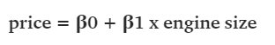
Example: Workings of a Linear regression Model
Model Building
He splits the data into training and test set. 75% of data is used for training. Remaining 25% is used for the test.
He builds a linear regression model. He uses a statistical package to create the model. The model creates a linear equation that expresses price of the car as a function of engine size.
The model estimates the parameters:
β0 is estimated as -6870.1
β1 is estimated as 156.9
The linear equation is estimated as:
price = -6870.1 + 156.9 x engine size

Slide 19
Example: Workings of a Linear regression Model
Interpretation
The model provides the equation for the predicting the average car price given a specific engine size. This equation means the following:
One unit increase in engine size will increase the average price of the car by 156.9 units.
Evaluation
The model is built. The robustness of the model needs to be evaluated.
How can we be sure that the model will be able to predict the price satisfactory?
This evaluation is done in two parts.
First, test to establish the robustness of the model (using hypothesis testing).
Second, test to evaluate the accuracy of the model (using the coefficient of determination a.k.a R-squared).
Fernando first evaluates the model on the training data. He gets the following statistics.

Slide 20
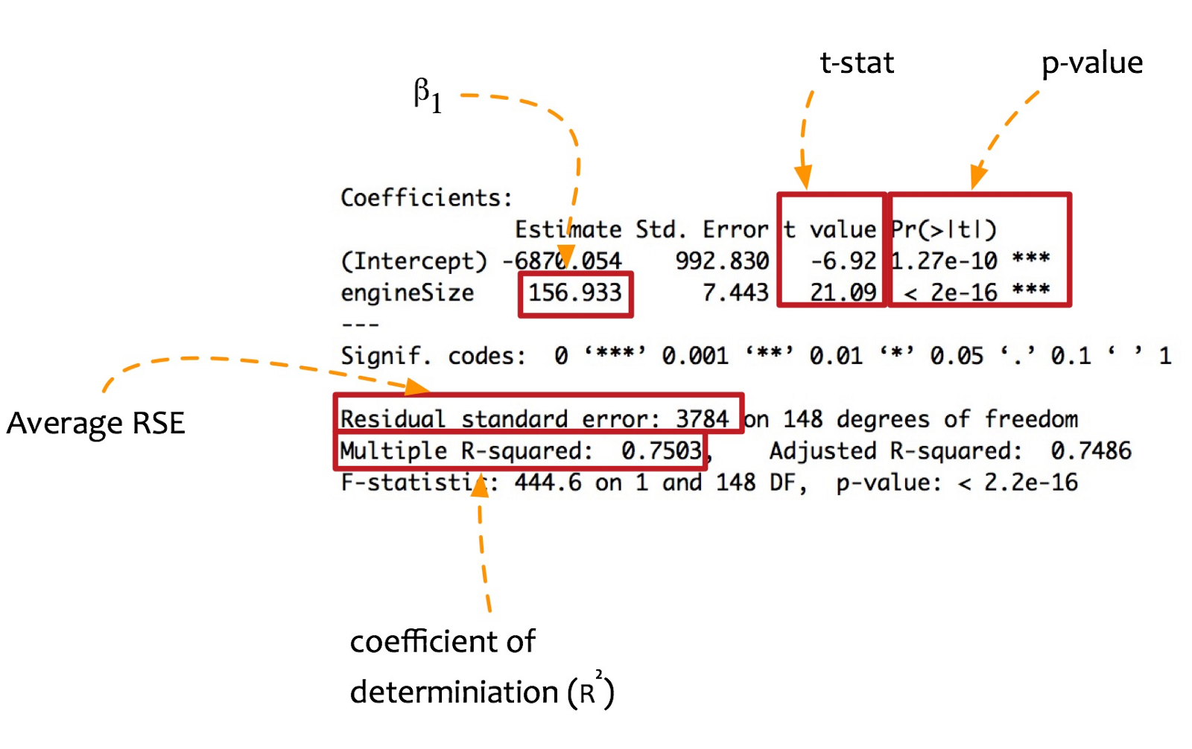
H0 and Ha need to be defined. They are defined as follows:
H0 (NULL hypothesis): There is no relationship between x and y i.e. there is no relationship between price and engine size.
Ha (Alternate hypothesis): There is some relationship between x and y i.e. there is a relationship between price and engine size.
β1: The value of β1 determines the relationship between price and engine size. If β1 = 0 then there is no relationship. In this case, β1 is positive. It implies that there is some relationship between price and engine size.
t-stat: The t-stat value is how many standard deviations the coefficient estimate (β1) is far away from zero. Further, it is away from zero stronger the relationship between price and engine size. The coefficient is significant. In this case, t-stat is 21.09. It is far enough from zero.
p-value: It indicates the chance of seeing the given t-statistics, under the assumption that NULL hypothesis is true. If the p-value is small e.g. < 0.0001, it implies that the probability that this is by chance and there is no relation is very low. In this case, the p-value is small. It means that relationship between price and engine is not by chance.
With these metrics, we can safely reject the NULL hypothesis and accept the alternate hypothesis.
There is a robust relationship between price and engine size.

Slide 21
How about accuracy? How accurate is the model? To get a feel for the accuracy of the model, a metric named R-squared or coefficient of determination is important.
The R-squared for the model created by Fernando is 0.7503 i.e. 75.03% on the training set. It means that the model can explain more than 75% of the variation.
Fernando has a good model now. It performs satisfactorily on the training data.
However, there is 25% of data unexplained.
There is room for improvement.
How about adding more independent variable for predicting the price?
When more than one independent variables are added for predicting a dependent variable, a multivariate regression model is created i.e. more than one variable.

Slide 22
Overall Idea of Regression
To examine two things:
Does a set of predictor variables do a good job in predicting an outcome (dependent) variable?
Which variables in particular are significant predictors of the outcome variable, and in what way do they–indicated by the magnitude and sign of the beta estimates–impact the outcome variable?
These regression estimates are used to explain the relationship between one dependent variable and one or more independent variables.

Slide 23
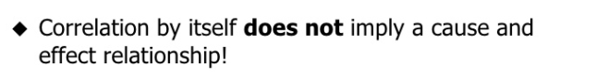
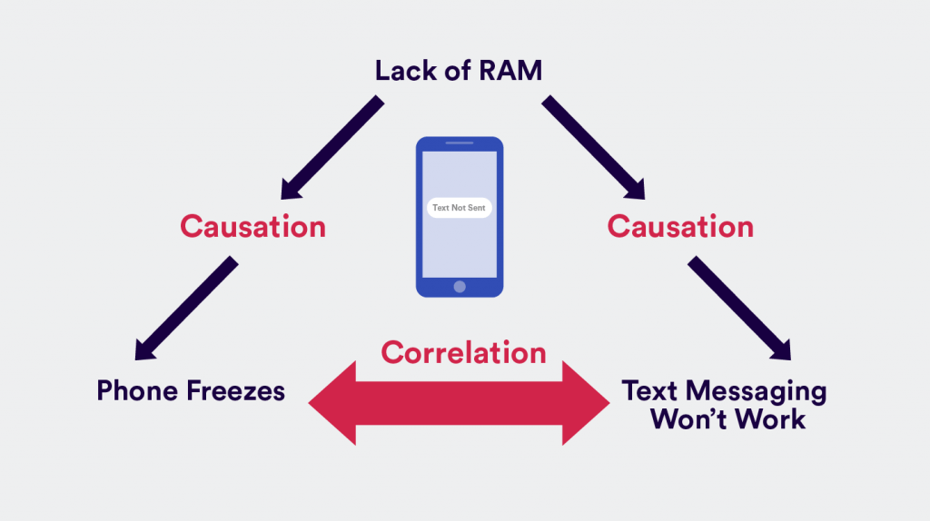
Correlation Vs Causation
Correlation is a term in statistics that refers to the degree of association between two random variables.
3 Types
Positive correlation is when you observe A increasing and B increases as well. Or if A decreases, B correspondingly decreases. Example: the more purchases made in your app, the more time is spent using your app.
Negative correlation is when an increase in A leads to a decrease in B or vice versa.
No correlation is when two variables are completely unrelated and a change in A leads to no changes in B, or vice versa.
It can sometimes be a coincidence!
Causation is implying that A and B have a cause-and-effect relationship with one another.
causation means that two events appear at the same time or one after the other.
it means these two variables not only appear together, the existence of one causes the other to manifest.
https://clevertap.com/blog/correlation-vs-causation/

Slide 24
Major Uses for Regression Analysis
Determining the strength of predictors - the regression might be used to identify the strength of the effect that the independent variable(s) have on a dependent variable. Typical questions are what is the strength of relationship between dose and effect, sales and marketing spending, or age and income.
Forecasting an effect - it can be used to forecast effects or impact of changes. That is, the regression analysis helps us to understand how much the dependent variable changes with a change in one or more independent variables. A typical question is, “how much additional sales income do I get for each additional $1000 spent on marketing?”
Trend forecasting - regression analysis predicts trends and future values. The regression analysis can be used to get point estimates. A typical question is, “what will the price of gold be in 6 months?”

Slide 25
Regression Analysis
The simplest case to examine is one in which a variable Y , referred to as the dependent or target variable, may be related to one variable X, called an independent or explanatory variable, or simply a regressor.
If the relationship between Y and X is believed to be linear, then the equation for a line may be appropriate:
Y = β1 + β2X,
where β1 is an intercept term and β2 is a slope coefficient.
In simplest terms, the purpose of regression is to try to find the best fit line or equation that expresses the relationship between Y and X.

Slide 26
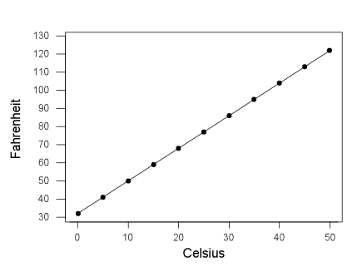
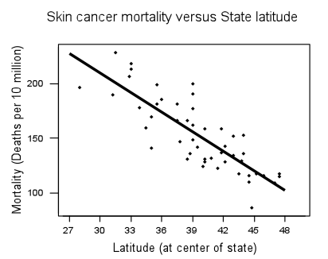
Types of Relationship
Deterministic (or Functional) Relationships
Statistical Relationships
An exact relationship between the predictor x and the response y. Take, for instance, the conversion relationship between temperature in degrees Celsius (C) and temperature in degrees Fahrenheit (F). We know the relationship is: F=95C+32
Therefore, if we know that it is 10 degrees Celsius, we also know that it is 50 degrees Fahrenheit:
F=95(10)+32=50
Not an exact relationship. It is instead a relationship in which "trend" exists between the predictor x and the response y, but there is also some "scatter“.

Slide 27
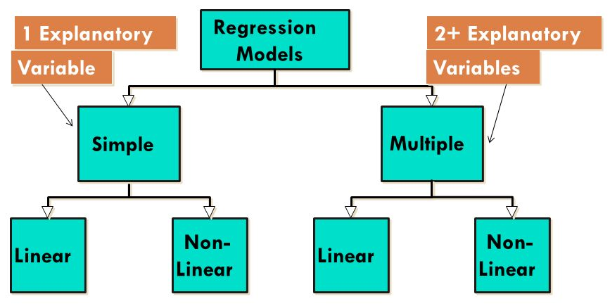
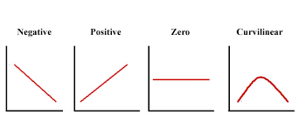
Types of Regression Analysis

Slide 28
Videos To Watch
Simple Linear Regression, The Very Basics
https://www.youtube.com/watch?v=ZkjP5RJLQF4
Regression Analysis
https://www.youtube.com/watch?v=DtOYBxi4AIE

Slide 29
Manual Computation
Regression computations are usually handled by a software package or a graphing calculator. For this example, however, we will do the computations "manually“.
Problem Statement
Last year, five randomly selected students took a math aptitude test before they began their statistics course. The Statistics Department has three questions.
What linear regression equation best predicts statistics performance, based on math aptitude scores?
If a student made an 80 on the aptitude test, what grade would we expect her to make in statistics?
How well does the regression equation fit the data?

Slide 30
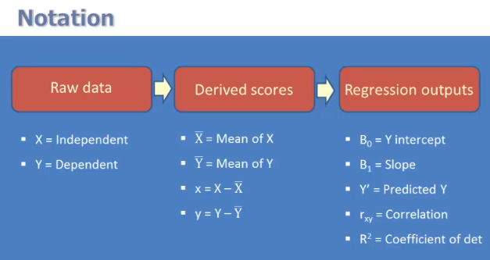

Regression Analysis By Hand
http://stattrek.com/regression/regression-example.aspx?Tutorial=AP

Slide 31
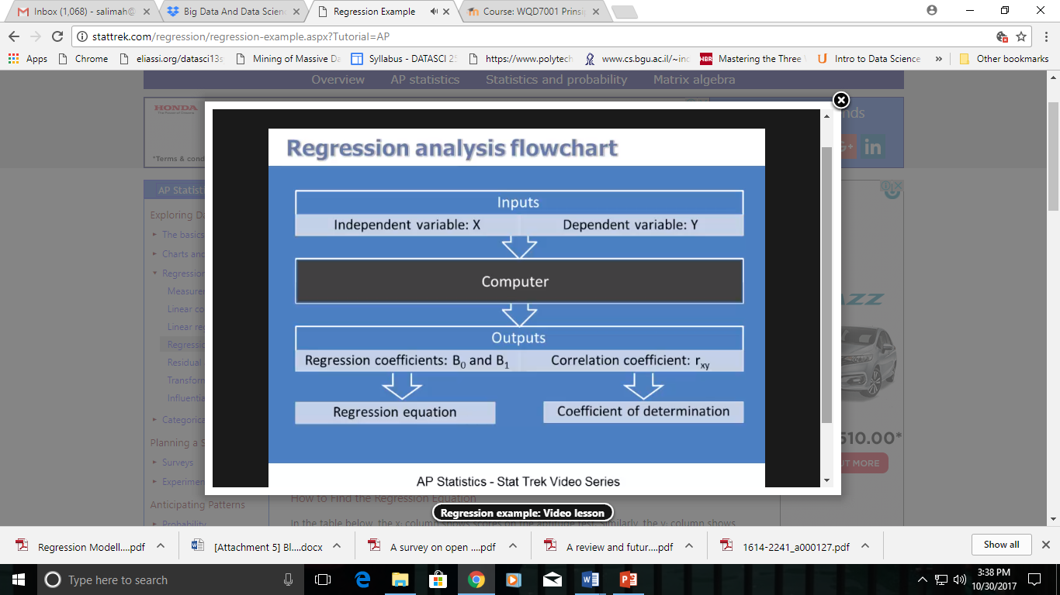
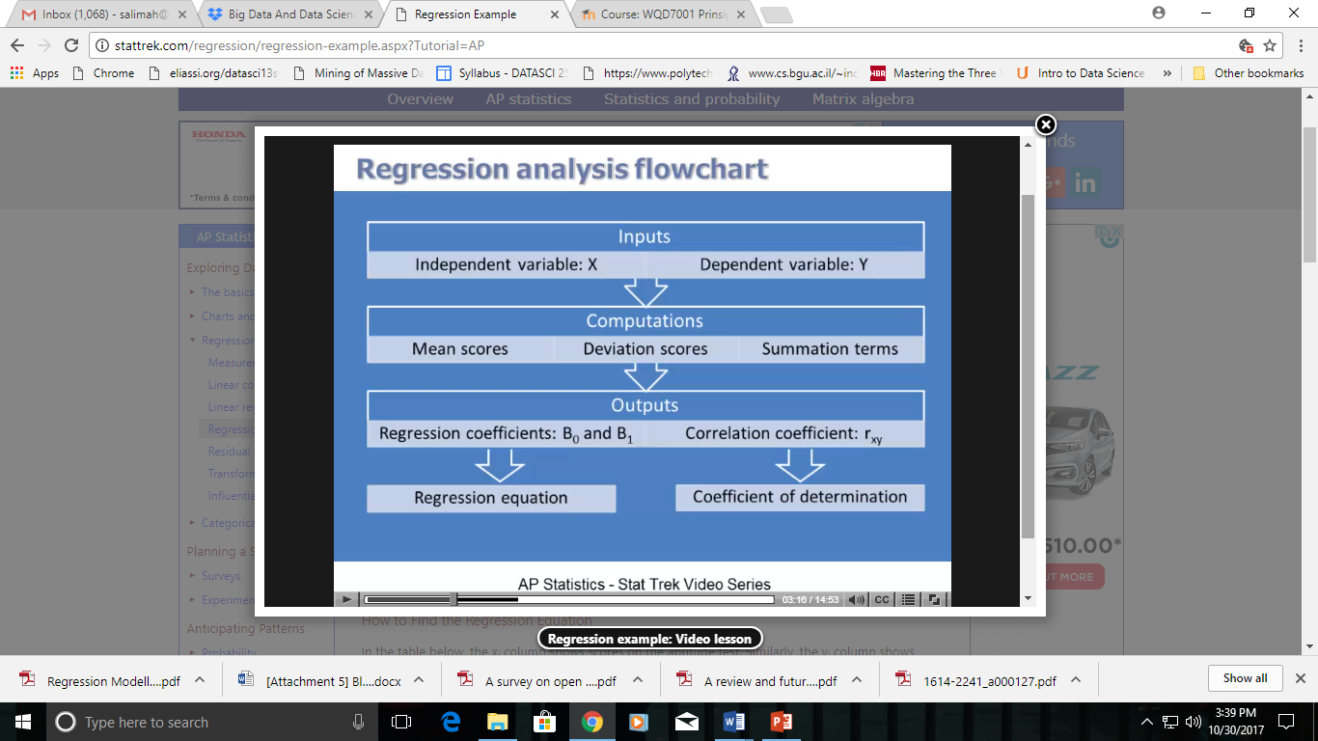

Slide 32
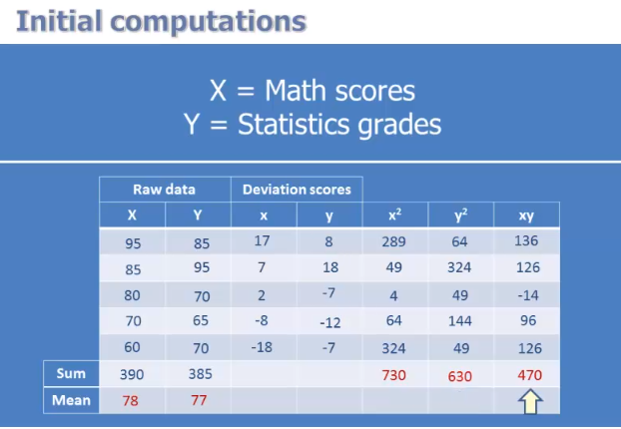

Slide 33
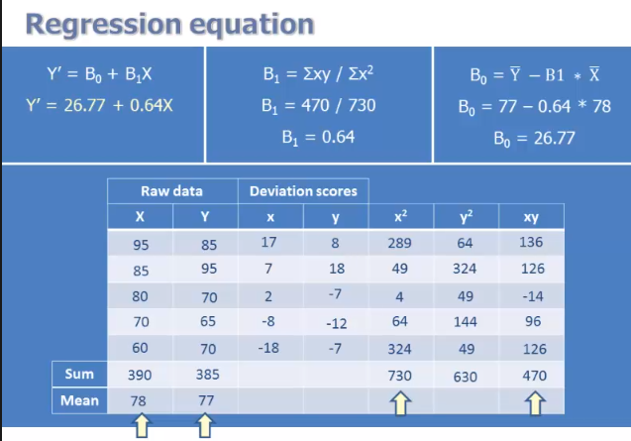

Slide 34
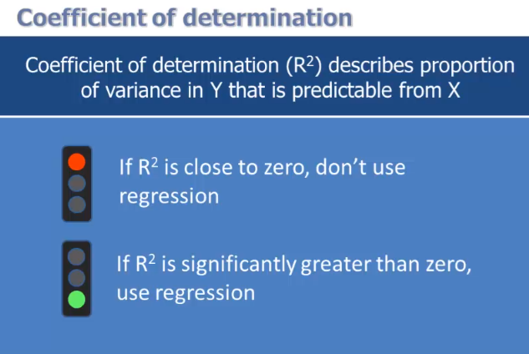

Slide 35
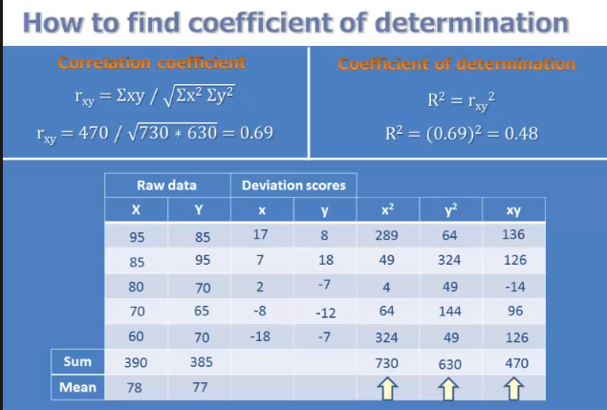
A coefficient of determination equal to 0.48 indicates that about 48% of the variation in statistics grades (the dependent variable) can be explained by the relationship to math aptitude scores (the independent variable). This would be considered a good fit to the data, in the sense that it would substantially improve an educator's ability to predict student performance in statistics class.

Slide 36
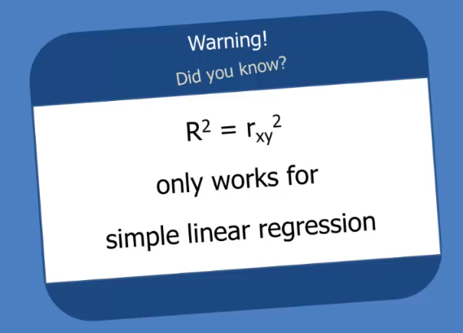

Slide 37
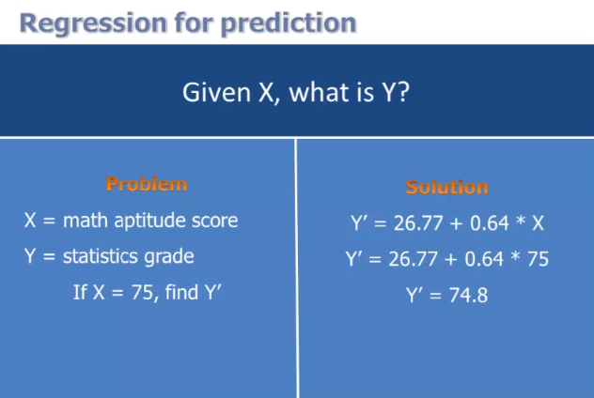

Slide 38
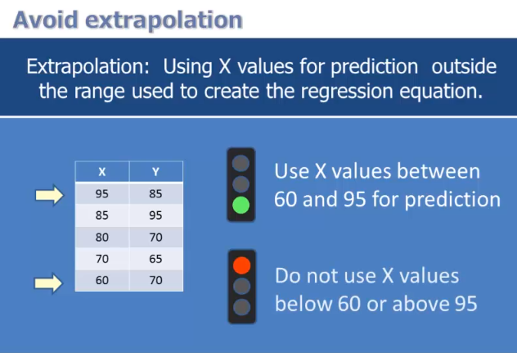
Warning: When you use a regression equation, do not use values for the independent variable that are outside the range of values used to create the equation. That is called extrapolation, and it can produce unreasonable estimates.

Slide 39
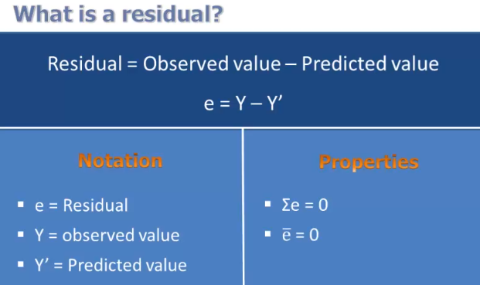
Residual Analysis in Regression
Because a linear regression model is not always appropriate for the data, you should assess the appropriateness of the model by defining residuals and examining residual plots.

Slide 40
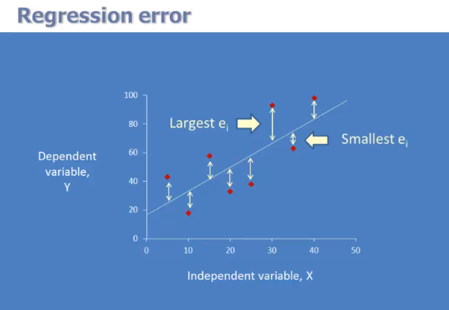

Slide 41
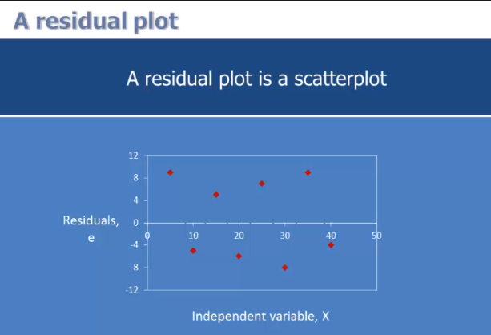
A residual plot is a graph that shows the residuals on the vertical axis and the independent variable on the horizontal axis. If the points in a residual plot are randomly dispersed around the horizontal axis, a linear regression model is appropriate for the data; otherwise, a non-linear model is more appropriate.

Slide 42
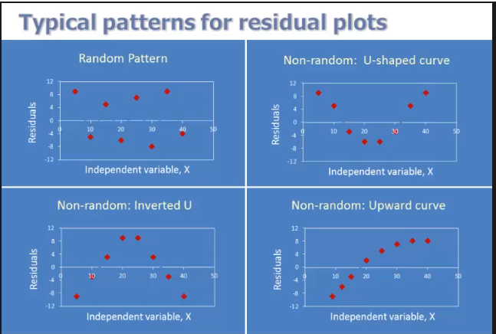

Slide 43
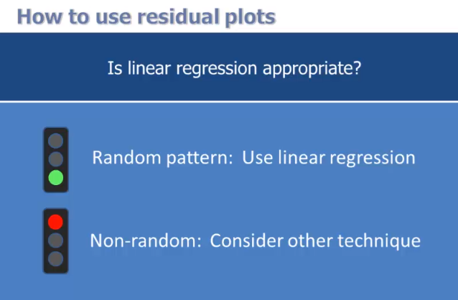

Slide 44
In the context of regression analysis, which of the following statements are true?
I. When the sum of the residuals is greater than zero, the data set is nonlinear.
II. A random pattern of residuals supports a linear model.
III. A random pattern of residuals supports a non-linear model.
(A) I only
(B) II only
(C) III only
(D) I and II
(E) I and III
Solution
The correct answer is (B). A random pattern of residuals supports a linear model; a non-random pattern supports a non-linear model. The sum of the residuals is always zero, whether the data set is linear or nonlinear.

Slide 45
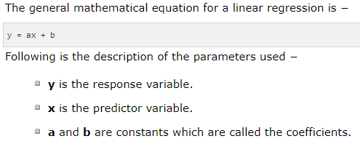
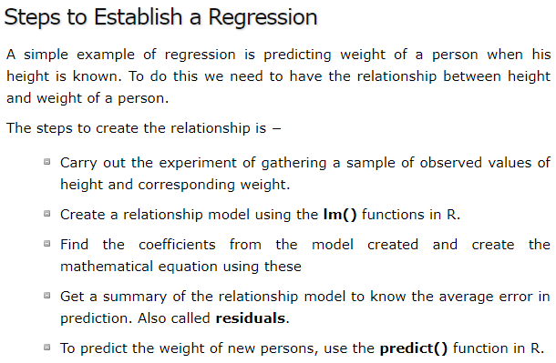
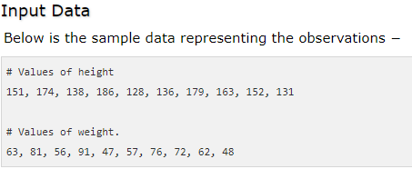
R - Linear Regression

Slide 46
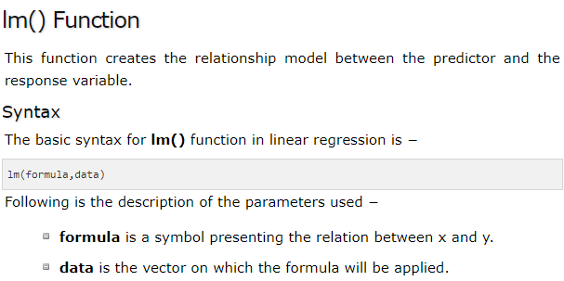
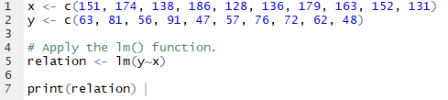
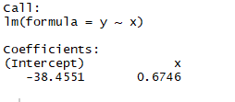
Create Relationship Model & get the Coefficients

Slide 47
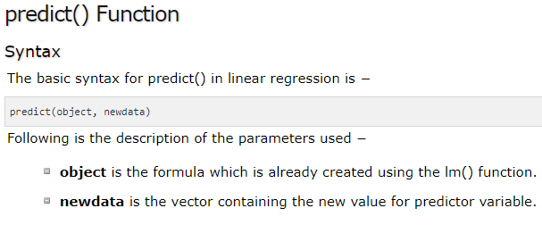
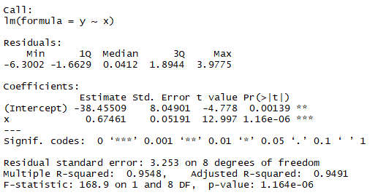
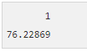
Get the Summary of the Relationship
print(summary(relation))
# The predictor vector.
x <- c(151, 174, 138, 186, 128, 136, 179, 163, 152, 131)
# The response vector.
y <- c(63, 81, 56, 91, 47, 57, 76, 72, 62, 48)
# Apply the lm() function.
relation <- lm(y~x)
# Find weight of a person with height 170.
a <- data.frame(x = 170)
result <- predict(relation,a)
print(result)

Slide 48
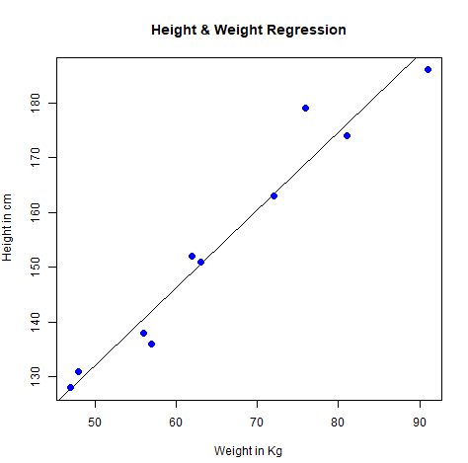
Visualize the Regression Graphically
# Create the predictor and response variable.
x <- c(151, 174, 138, 186, 128, 136, 179, 163, 152, 131)
y <- c(63, 81, 56, 91, 47, 57, 76, 72, 62, 48)
relation <- lm(y~x)
# Give the chart file a name.
png(file = "linearregression.png")
# Plot the chart.
plot(y,x,col = "blue",main = "Height & Weight Regression",
abline(lm(x~y)),cex = 1.3,pch = 16,xlab = "Weight in Kg",ylab = "Height in cm")
# Save the file.
dev.off()

Slide 49
Reference
http://stattrek.com/regression/regression-example.aspx?Tutorial=AP
Book - Statistical Methods for Categorical Data Analysis, By Daniel Powers, Yu Xie
https://www.tutorialspoint.com/r/r_linear_regression.htm
https://www.statisticssolutions.com/what-is-linear-regression/
http://onlinestatbook.com/2/regression/intro.html
https://www.dezyre.com/data-science-in-r-programming-tutorial/linear-regression-tutorial
https://www.datasciencecentral.com/profiles/blogs/data-science-simplified-part-4-simple-linear-regression-models-1

